Slide 1
Topic detection and Semantic analysis
Alp Yalcin

Slide 2

Topic detection and semantic analysis
Goal: Conduct topic detection and semantic analysis of texts.
Idea: Texts with similar content need to be grouped together, while texts with dissimilar content must be effectively segregated from these groups.
Detecting emerging topics and accurately representing them in well-defined clusters is crucial.
To achieve these goals, a blend of various techniques is utilized.
This presentation briefly explains the strategies for tackling these challenges and the process of model development.

Slide 3
Overview
Dataset explanation
Text preprocessing
Pretrained models in NLP, Transformers, BERT explanation
Usage of neural networks on top of embeddings for enhancement
Clustering methods and dimensionality reduction
Initial experiment
Improvement of the previous experiment with HDBSCAN on top of clustering
Interactive tools for different use cases
Q/A and comments

Slide 4
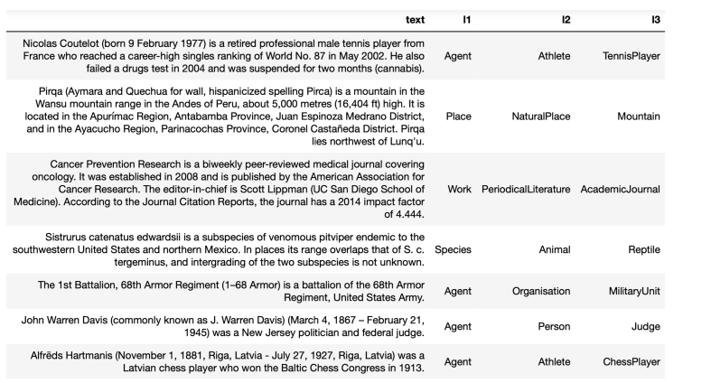
Dataset

Slide 5
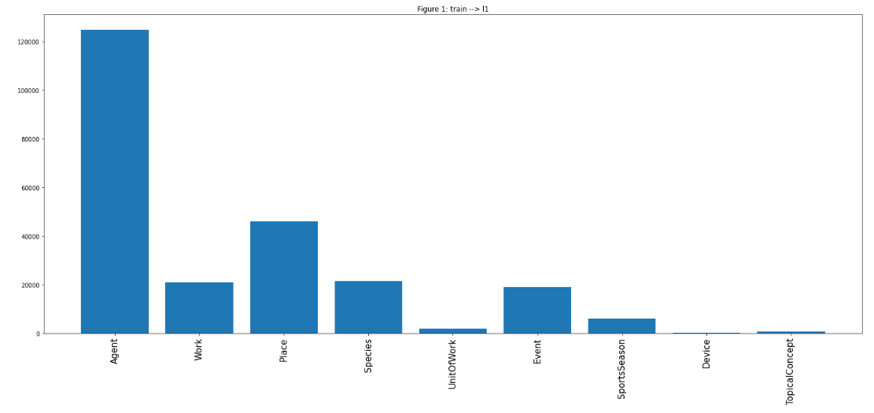
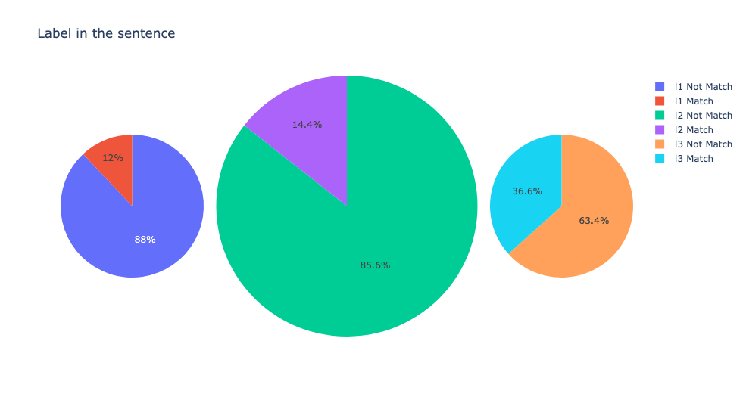
Dataset
Agent: 124,798 text observations
Device: 248 text observations
Presence / Absence of the class names within the text observations

Slide 6
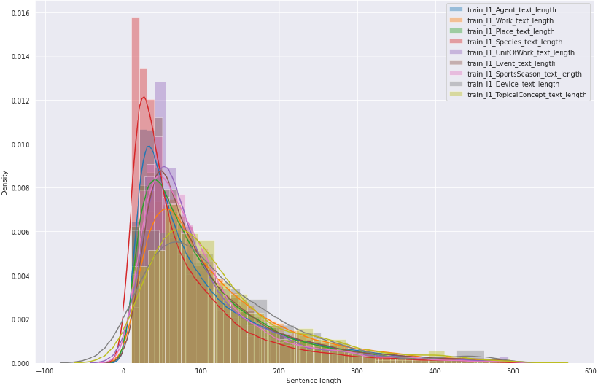
Dataset
95% of all text lengths are 298 tokens

Slide 7
Text Preprocessing
NLTK library and Regular expression libraries are used for text preprocessing ;
Tokenization
Punctuation – Regular expression (re) : compile, sub, escape
Lowercase conversion
Stopwords removal
Lemmatization
Frequency distribution analysis
Extracting most common words

Slide 8
Text Preprocessing – NLTK WordNet tool
NLTK Wordnet
Synsets: specific meaning or concepts that words can have
Identify appropriate synset for a given word based on its meaning
Hypernyms: More general categories or concepts
Hierarchical relationships within the network
Semantic Graphs
Visual representation of the connections and relationships between words or concepts

Slide 9
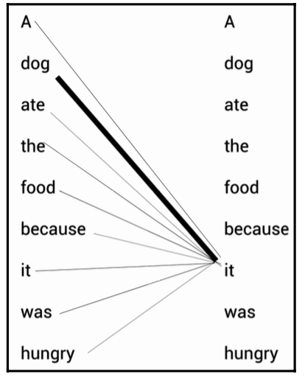
Text Embeddings – Pretrained models and Transformer Architecture
Pretrained models in NLP : trained on large amounts of unlabelled data, then fined tuned on specific tasks using smaller labelled datasets.
Transformer architecture :
Self Attention mechanism
Encoder – decoder

Slide 10
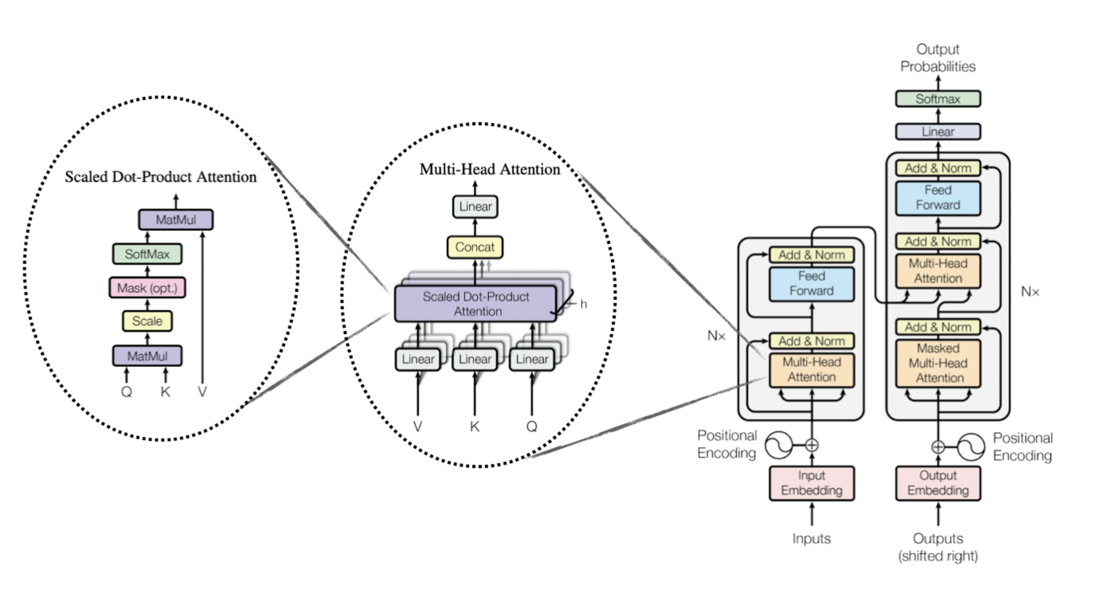
Text Embeddings – Pretrained models and Transformer Architecture

Slide 11
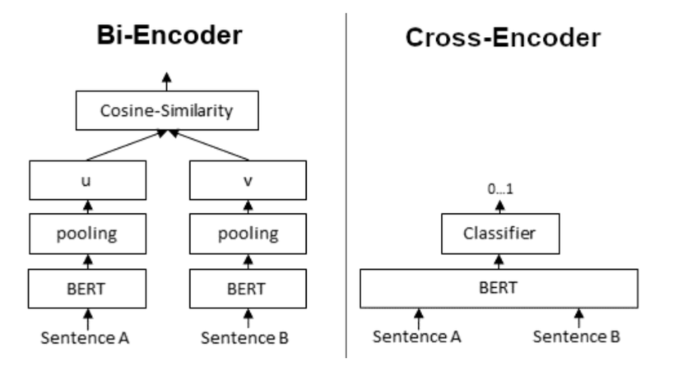
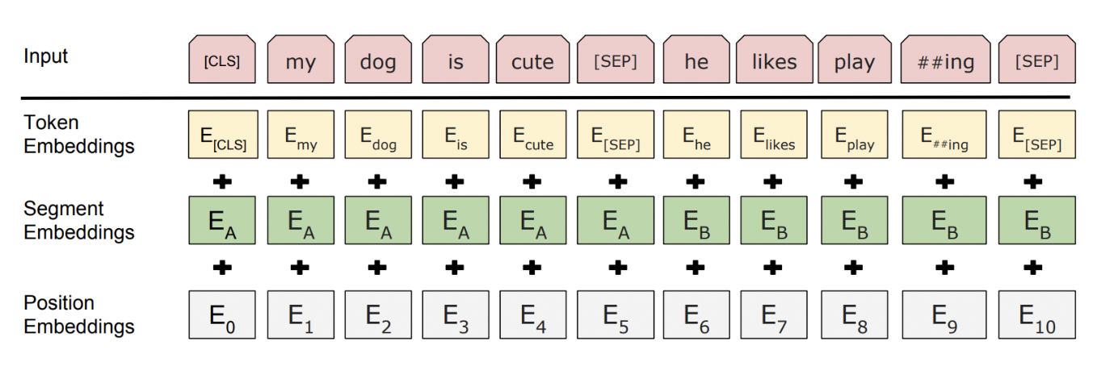
Text Embeddings - BERT
BERT(Bidirectional Encoder Representation from Transformers) model uses the encoder architecture of the transformer model in a bidirectional method.
Transformer encoder building blocks:
Input representation
Attention mechanism
Pre-training
Masked Language modelling
Next sentence prediction

Slide 12
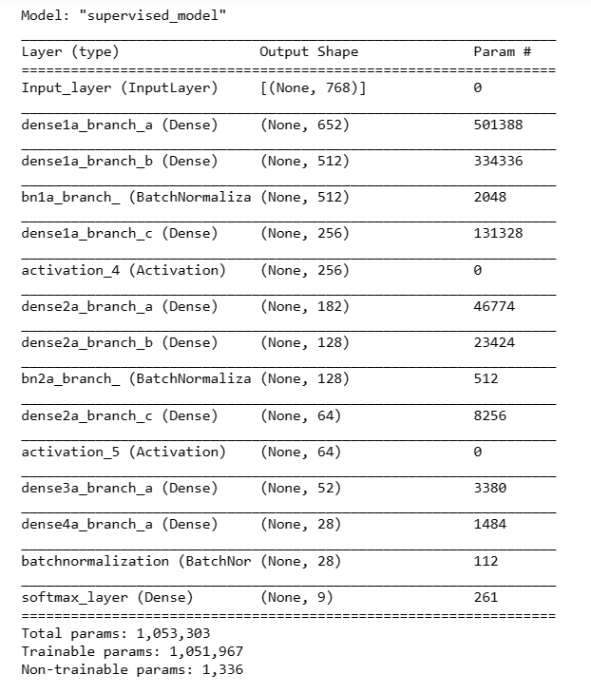
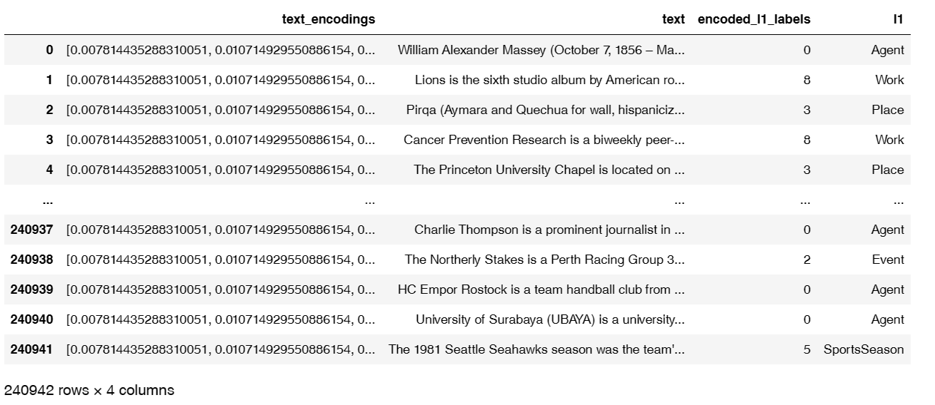
Text Embeddings – Neural Network
A neural network supervised model architecture is used to improve the quality of the embeddings and reduce the dimensionality from 768 dimensions to 28-dimensional embeddings.

Slide 13
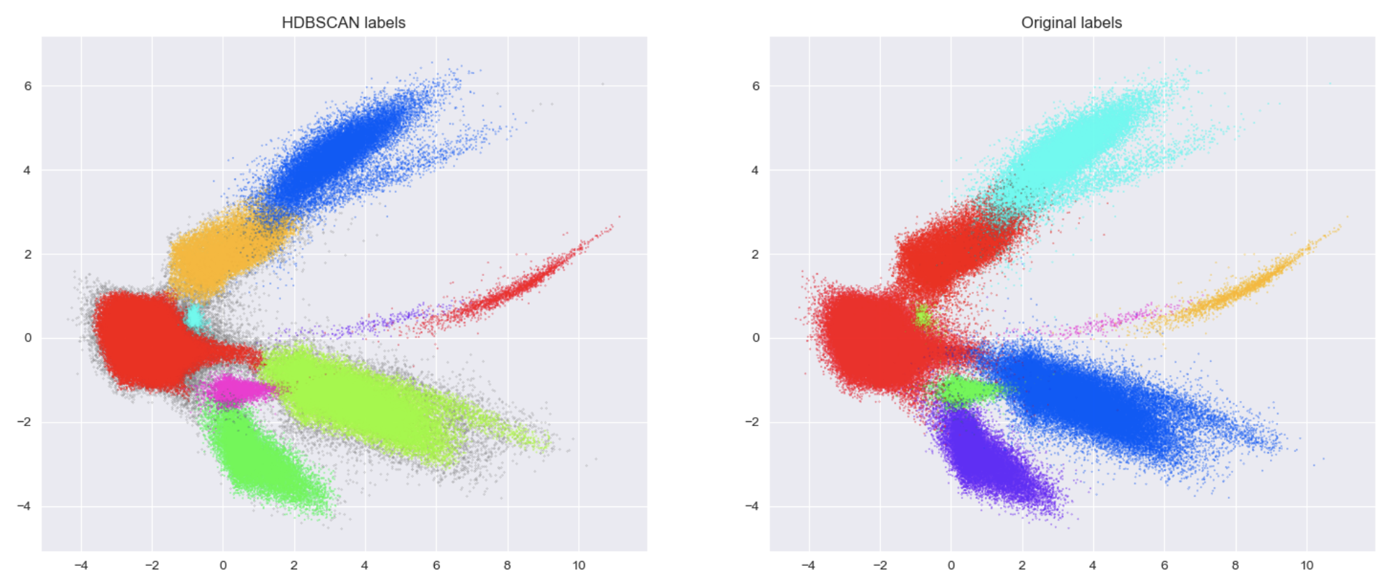
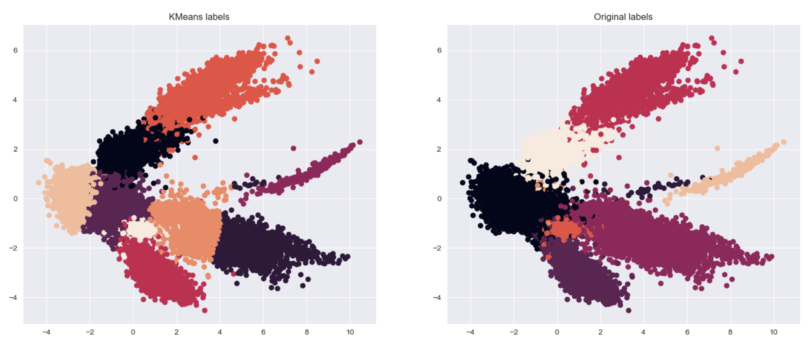
Clustering Approaches
K-means and HDBSCAN are unsupervised methods used for clustering models.
Silhouette score is used to assess the quality of the clusters (Intra cluster, Inter cluster variances)
PCA is implemented for 2 dimensional embedding space for visualization of clustering
Silhouette score for predicted labels with KMeans: 0.48188227
Silhouette score for predicted labels with HDBSCAN: 0.62643075
Silhouette score for original labels: 0.6811199

Slide 14
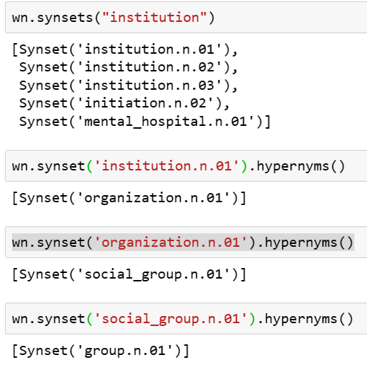
Clustering Approaches – Hypernyms
Hypernyms for all words in each classes are calculated as follows;
Most frequent 50 words + all synonymous words
Calculating the hypenyms for all words + synonymous
From these hypernyms, 50 most frequent hypernyms are saved as Level 1 hypernyms
Calculation of level 1 hypernyms obtained in stage 3 and most frequent 50 words are saved as level 2 hypernyms
This process is repeated once again for the level 2 hypernyms and saved as level 3 hypernyms
All synonymous words for “institution” word are found
Level 1 hypernym for institution.n.01 word
Level 2 hypernym
Level 3 hypernym

Slide 15
Node Graphs – Path Similarity
Node graphs created for each hypernym list.
Visualize hypernym graphs using GraphX library.
Calculate pairwise similarities using path_similarity function.
Set similarity threshold for word pairs.
Connect word pairs exceeding similarity threshold.
5-6 distinct node connections observed in each graph.
Color connected word pairs in node graphs.
Identify connections based on path similarity.

Slide 16
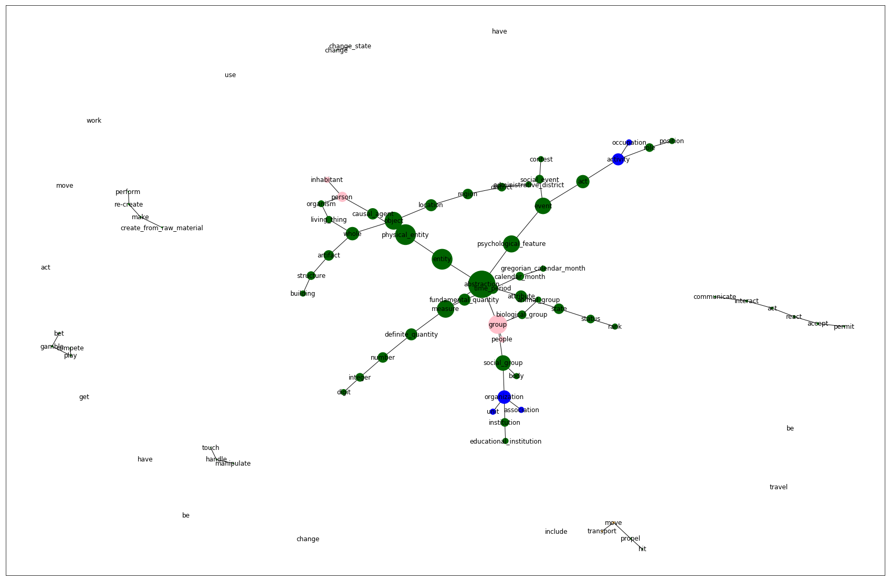
Node Graphs – Agent class hypernyms
Living organism
Subgroup
creativity
subgroup
compete
subgroup
Action subgroup
Organization subgroup

Slide 17
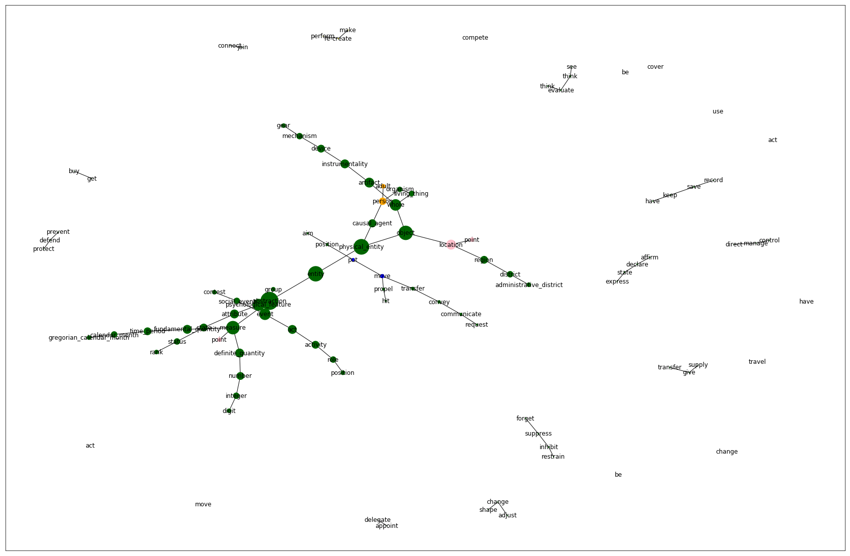
Node Graphs – Event class hypernyms
Location subgroup
Creativity
subgroup
Time subgroup

Slide 18
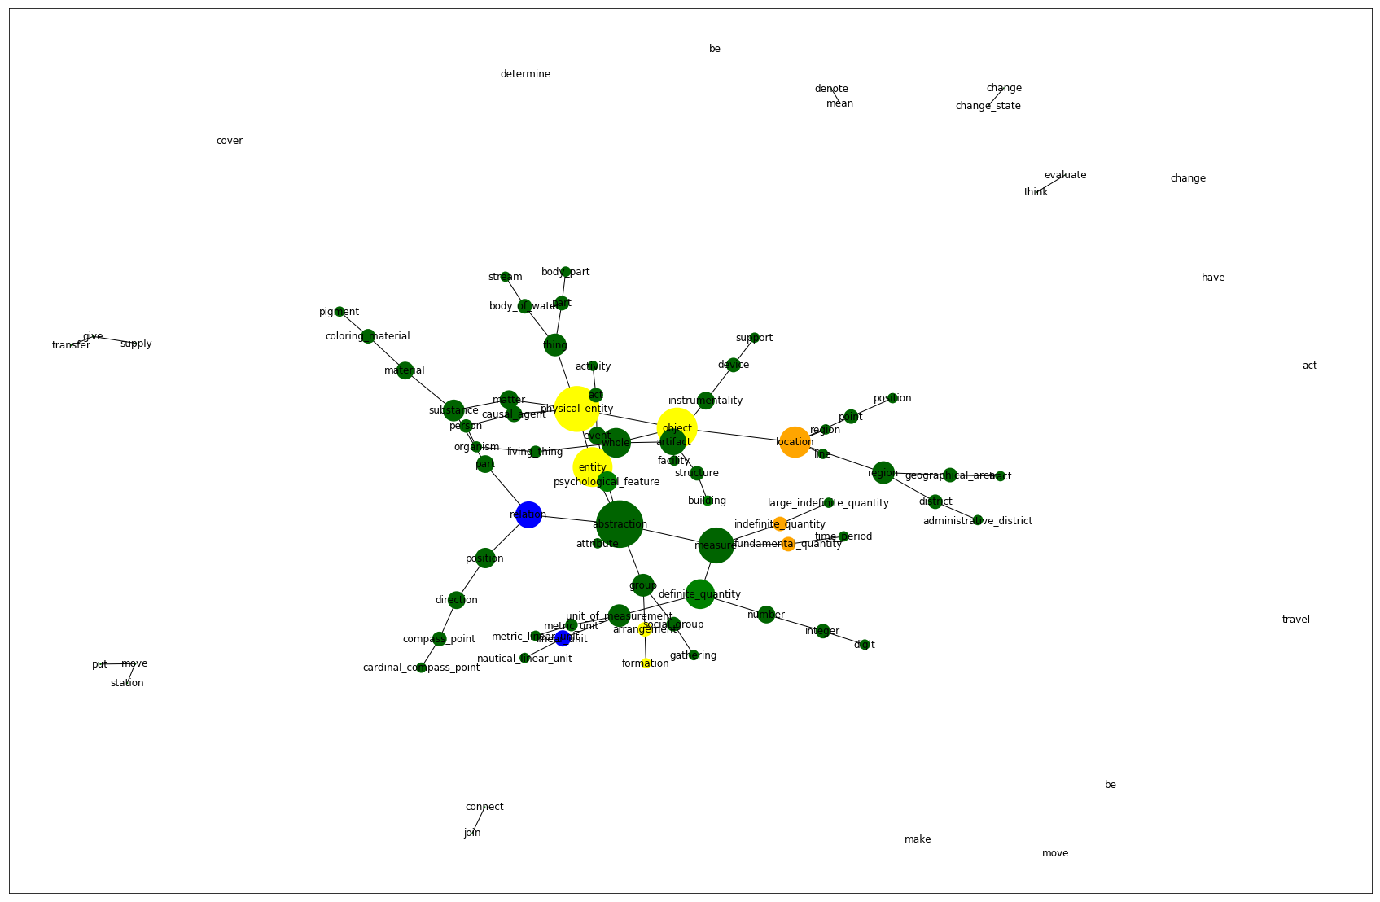
Node Graphs – Place class hypernyms
Bridge/river / canal / lake
Natural places
Structure subgroup
Region / Location subgroup
Direction /Compass
Navigating subgroup

Slide 19
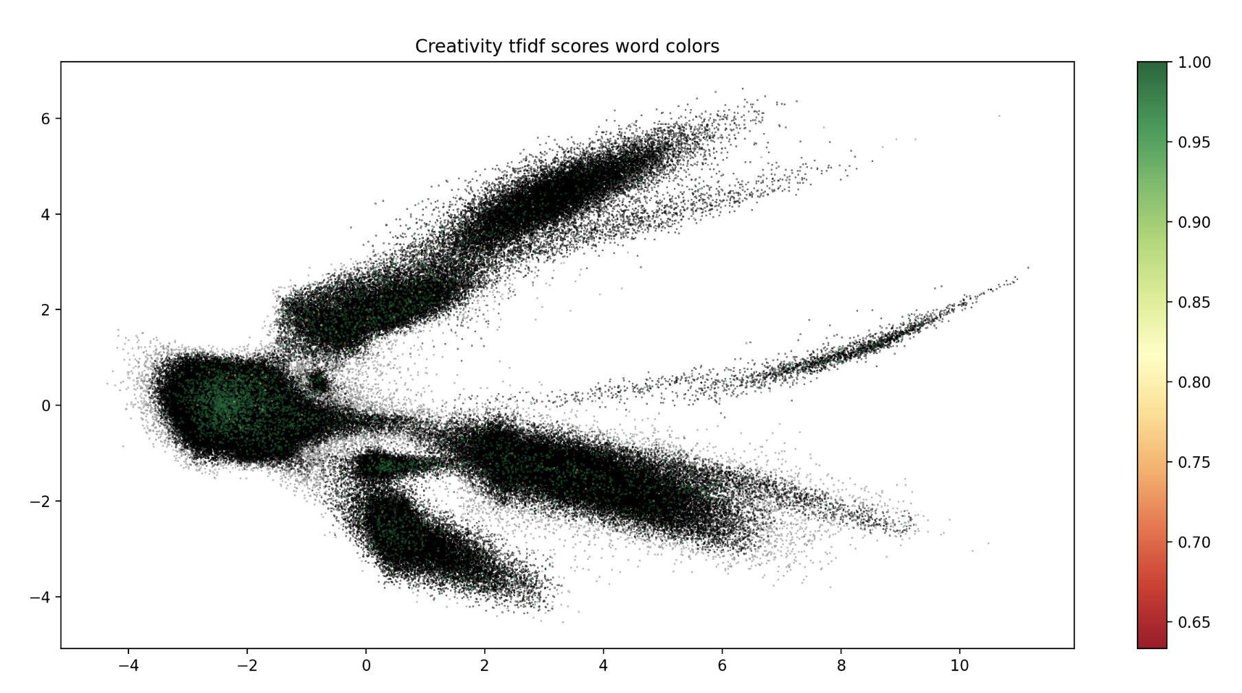
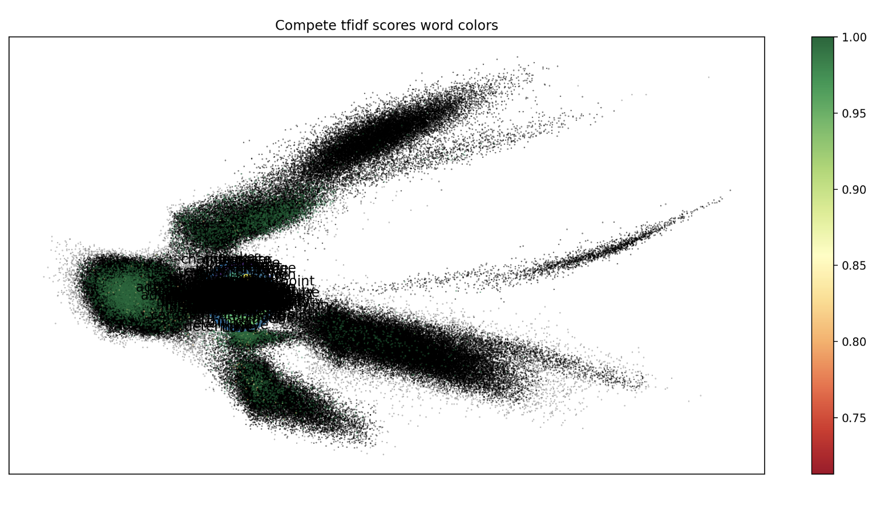
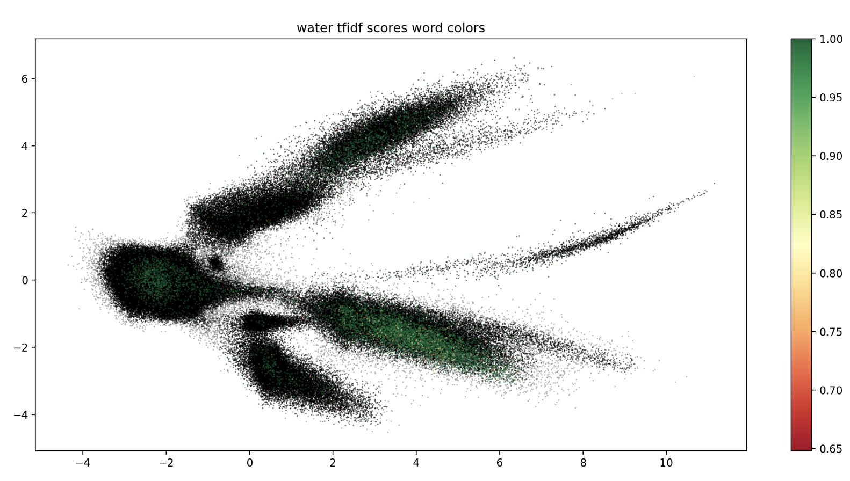
Node Groups in Embedding Space
Goal: Understand how these groups of words are used and how relevant they are to each observation.
TF-IDF Score Analysis: Importance and frequency of words in a text corpus.
Expectation: Identify dense observation clusters as subtopics based on green-colored points in the embedding space, indicating proximity and separation from other points.
creativity = ['perform', 're-create', 'make','create','raw material’] compete = ['bet', 'gamble', 'play', 'compete’]. water = ['stream', 'body of water', 'lake','water','waterfall']

Slide 20
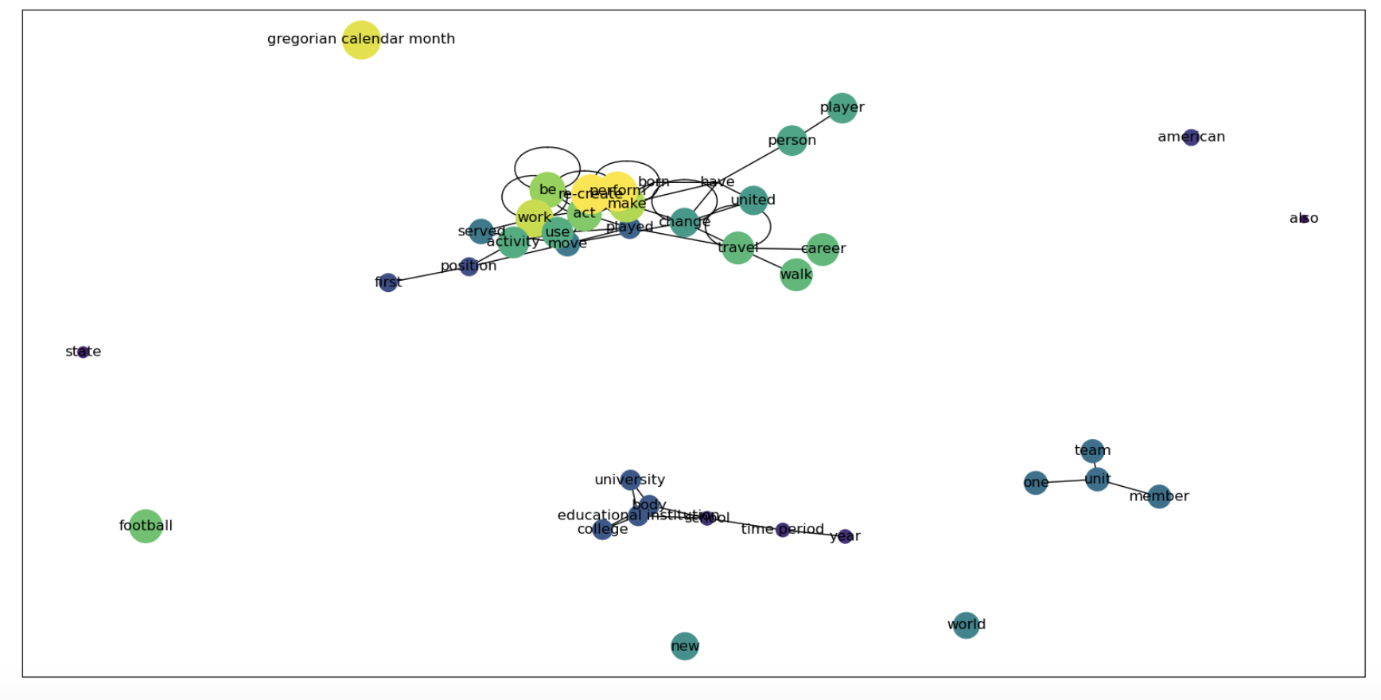
Improvements – Community Groups
Community groups for frequent words and hypernyms are calculated using the community_louvain library, creating groups automatically with adjustable size and density.
Networkx algorithm calculates centrality measures (degree, betweenness, closeness, eigenvector) to determine node importance and influence in the network.

Slide 21
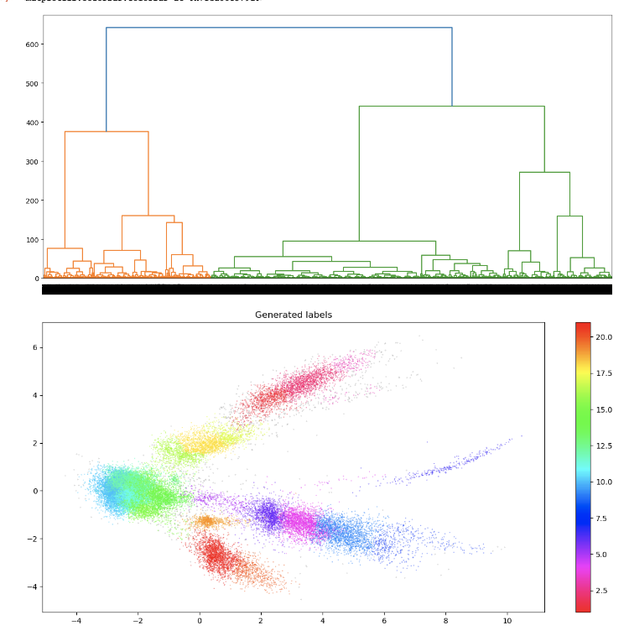
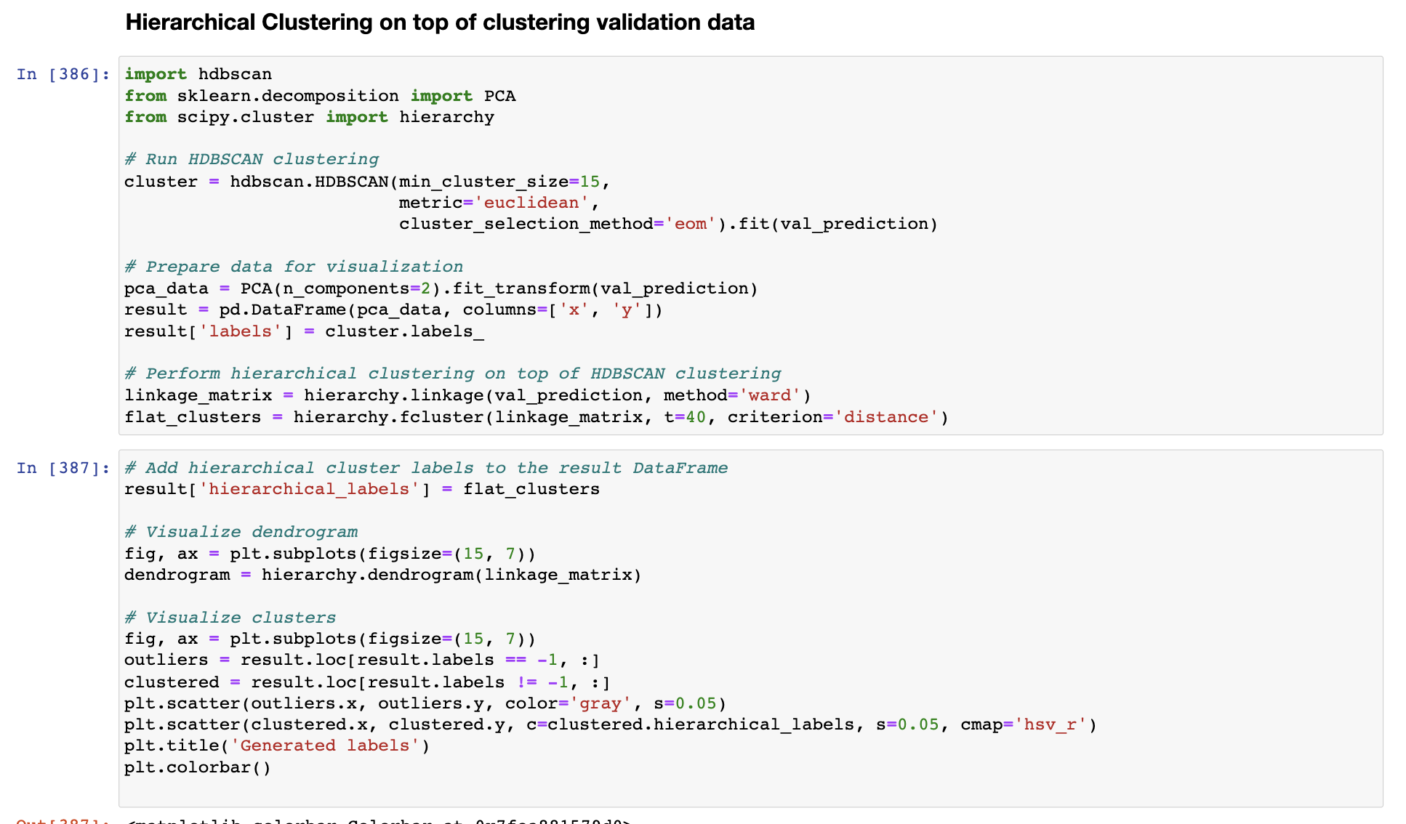
Improvements – Hierarchical clustering on top of HDBSCAN

Slide 22
Giving topic names to new 21 Hierarchical Clusters
Obtained 21 clusters instead of 9, used as "hierarchical_labels" for analysis.
Extracted most frequent words, hypernyms, and hypernyms of frequent words.
Calculated wordnet graphs for 21 clusters using community Louvain algorithm.
Removed abstract words like 'be', 'do', 'have' from the top words and top hypernyms.
Assigned topic names to each of the 21 classes based on the top words and top hypernyms.
Extracted distinctive and specific topics for some classes, while further exploration is needed for others.

Slide 23
Cluster | Category | Top Words | Top Hypernyms | Top Word Hypernyms
1 | Species | species, family, genus, found, known, one, habitat, name | travel, taxonomic group, person, time period, experience | family: taxonomic group<br>genus: taxonomic group<br>found: get, experience<br>known: experience
2 | Species - Plants | species, family, genus, found, habitat, known, forest, endemic, tropical | taxonomic group, currency, person, experience, unit, collection | family: taxonomic group, unit, collection<br>genus: taxonomic group<br>found: get, experience<br>known: experience
3 | Species - Animals (Horses) | species, race, stake, genus, family, thoroughbred, racehorse, desmopachria | travel, taxonomic group, time period, digit | race: travel, move, taxonomic group, act<br>genus: taxonomic group<br>family: taxonomic group
4 | Natural Places and Structures | located, river, state, bridge, lake, mountain, county, airport, km | structure, location, travel, administrative district, position | state: administrative district<br>bridge: structure<br>county: administrative district
5 | Railway and Public Transit System | line, railway, service, station, system, city, rail, new, operated | mark, activity, formation, location, travel, position | line: formation, location<br>station: move, position<br>operated: move
6 | Railways and Museums - Travel | line, located, station, museum, railway, state, airport, city, new | move, travel, position, location, mark, administrative district | line: location<br>station: move, position<br>state: administrative district<br>city: administrative district
7 | Legal Cases and Law | court, state, united, case, supreme, decision, law | government, administrative district, person, area, container, metallic element | court: act, government, area<br>state: government, administrative district<br>united: change, have<br>case: person
8 | Celestial Body and Astronomy | asteroid, river, dam, church, located, orbit, lake, discovered, planet, km | time period, location, structure, metric linear unit, travel, celestial body | dam: metric linear unit<br>planet: celestial body<br>km: metric linear unit
9 | Natural Places | river, lake, located, mountain, county, km, state, south | location, administrative district, travel, structure, direction, region | county: administrative district, region<br>state: administrative district<br>south: location, direction
10 | Sport Player | born, team, played, league, season, player, coach, national, football, university | perform, move, make, time period, travel | born: act, have<br>played: act, perform<br>season: time period
11 | Sport Player | born, world, team, championship, played, first, state, american, league | travel, make, time period, person, perform | born: act, have<br>played: act, perform
Cluster | Category | Top Words | Top Hypernyms | Top Word Hypernyms
12 | Person | born, state, school, american, first, year, university, played, one | move, time period, travel, work, gregorian calendar month | born: act, have<br>school: time period<br>year: time period<br>played: act
13 | Music Genre | music, genre, rock, style, band, also, song, popular, new, pop | sound, activity, auditory communication, travel, punishment | music: sound, activity, auditory communication, punishment<br>rock: move<br>song: sound<br>pop: sound
14 | Educational Institutions and Companies | school, university, state, service, city, one, new, bank, company | time period, travel, activity, educational institution, body | school: time period, educational institution, body<br>university: educational institution, body
15 | Sport Organizations | team, league, party, first, record, new, club, national | time period, travel, person, unit, perform | team: unit<br>party: person<br>one: unit<br>national: person
16 | Music | album, song, released, single, first, band, music, one, series | make, sound, time period, travel, pass, activity | music: sound, activity
17 | Games and Music | game, released, album, published, song, journal, play, first, single, series | activity, travel, sound, diversion, play | game: activity, diversion<br>song: sound<br>play: diversion
18 | Periodical Publications and Musical Works | album, released, song, single, game, published, first, series, magazine | make, travel, time period, sound, pass, issue | released: pass, issue<br>song: sound
19 | Sport Season | season, team, football, league, game, first, record, th, division, coach | time period, weaken, toughen, end, travel, point | season: time period, weaken, toughen<br>first: point
20 | Contests, Sport Events, and Elections | election, event, race, state, place, final, first, battle | travel, time period, contest, point, position | race: move, act, travel, contest<br>place: point<br>took: have, position<br>first: point, position
21 | Contests and Sport Events | event, first, cup, race, final, tournament, match, championship, team | travel, time period, contest, point, group | first: point<br>race: move, act, travel, contest, group<br>tournament: contest<br>match: change, contest<br>championship: contest<br>team: group

Slide 24
Hierarchical Clusters analysis
Cosine similarities are calculated within each cluster and across different clusters to assess cluster
Subclusters are compared to understand how they are split after hierarchical clustering improvement.
Text pairs with low cosine similarity scores are extracted for more detailed analysis. Text pairs with low cosine similarity scores are colored in the embedding space to identify subclusters within clusters.
Sparse text pairs within each cluster are analyzed to find more dense subclusters.
The analysis of pairwise cosine similarity within and across clusters provides insights into the relationships and distinctions between the texts.

Slide 25
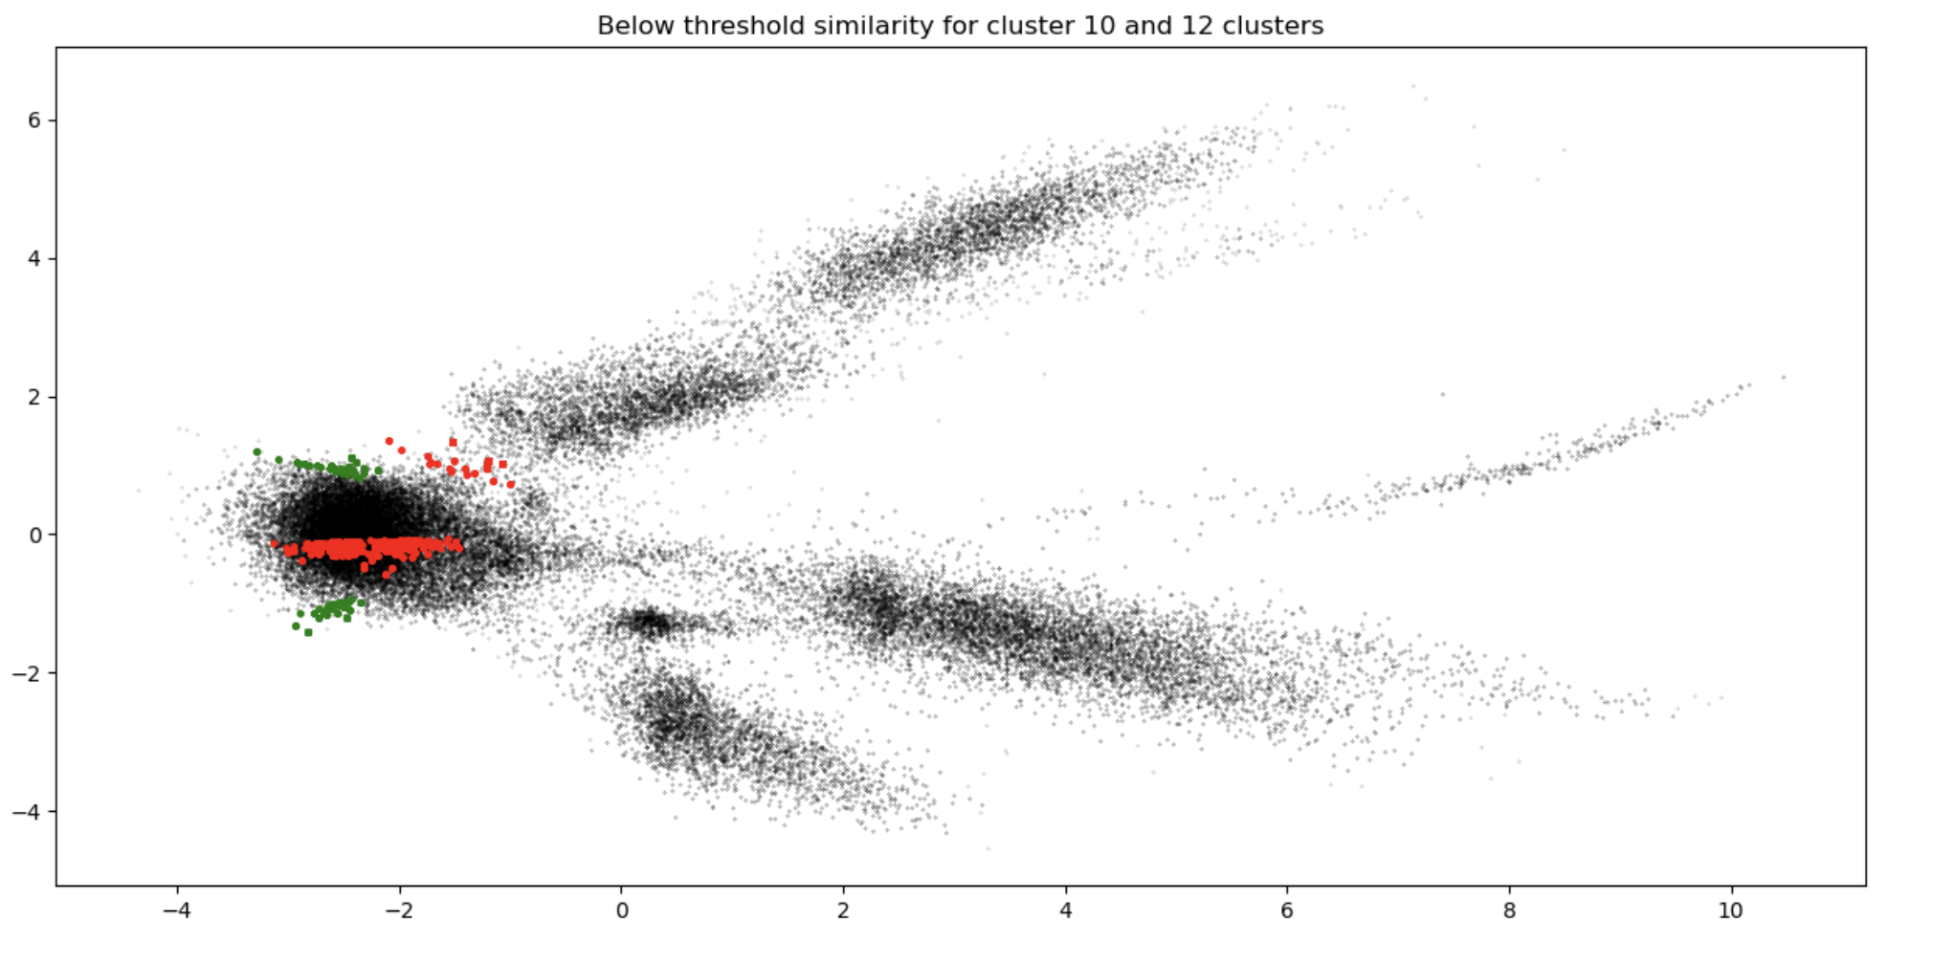
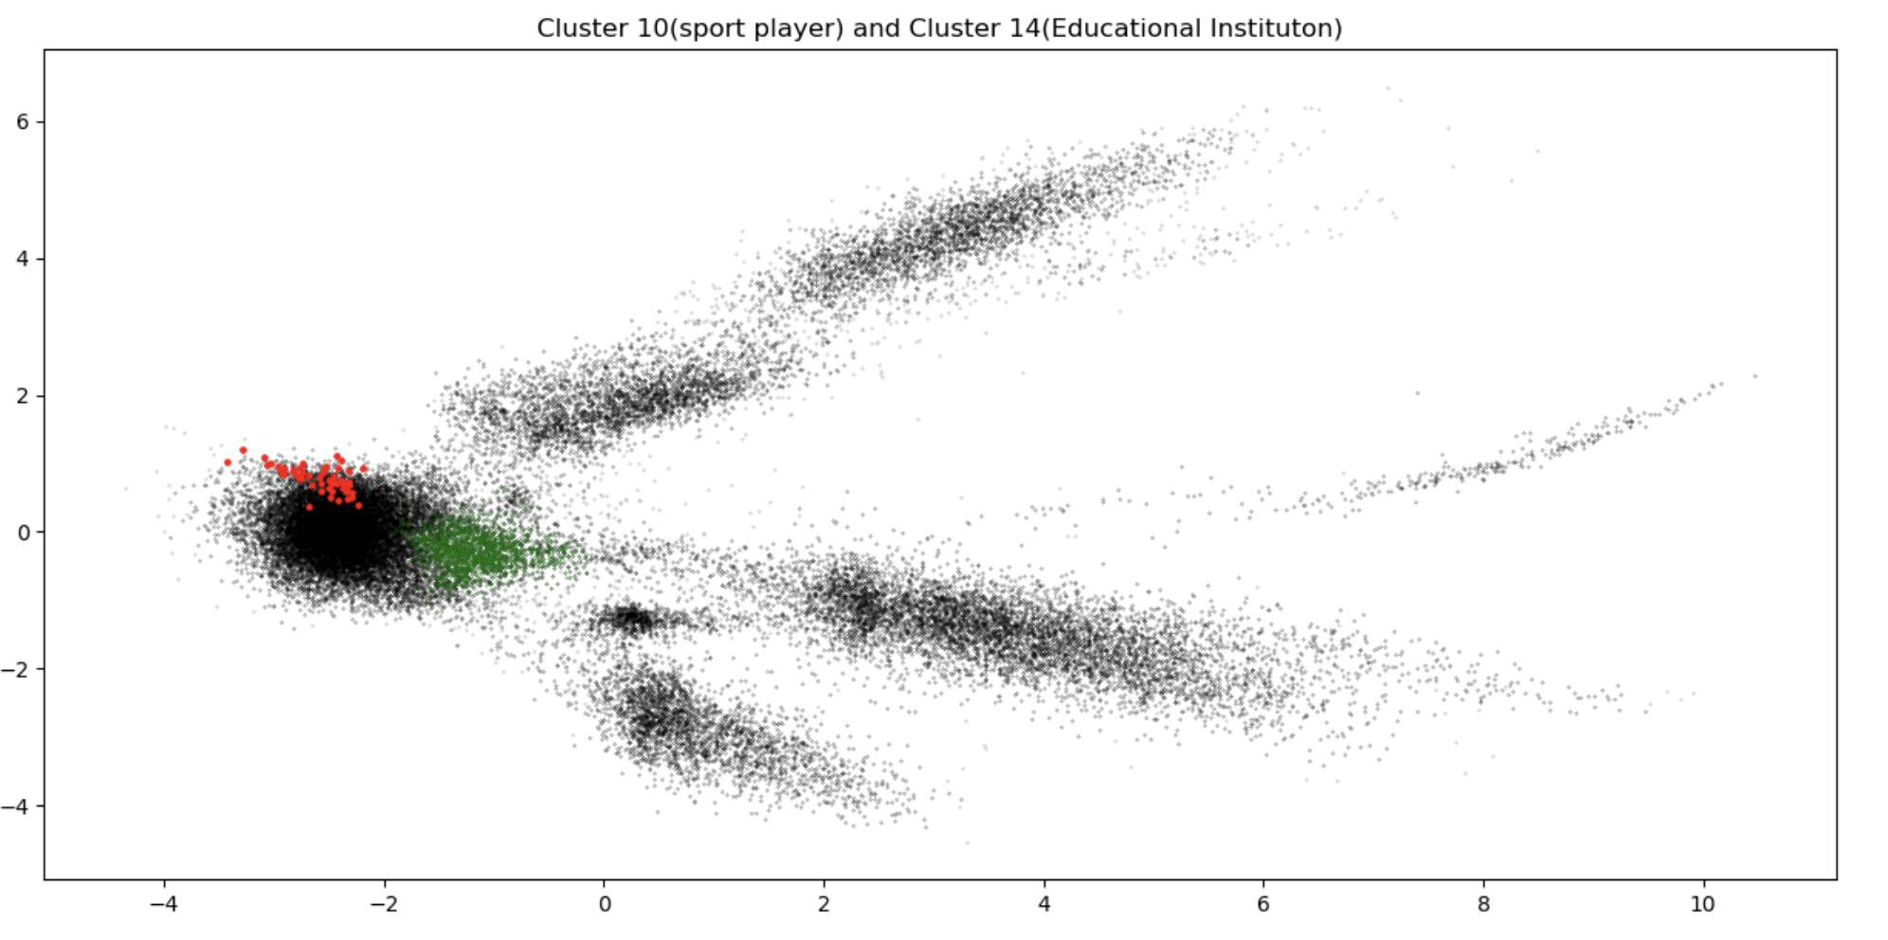
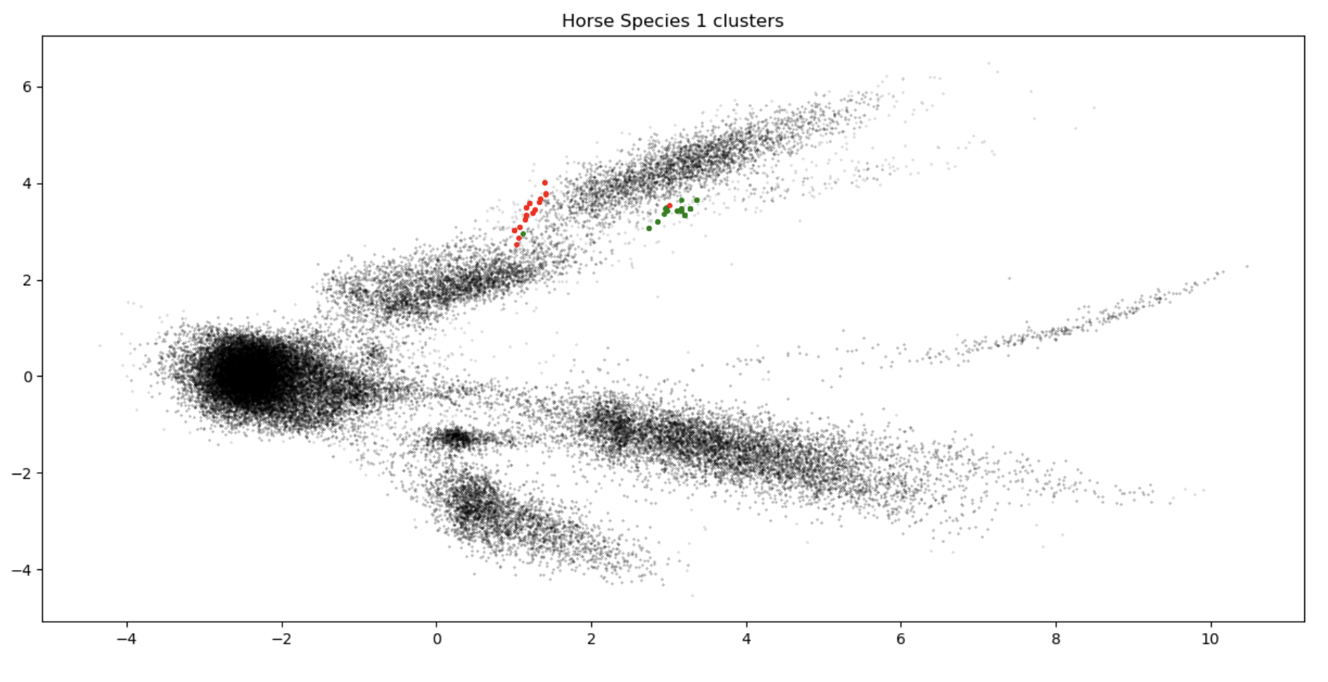
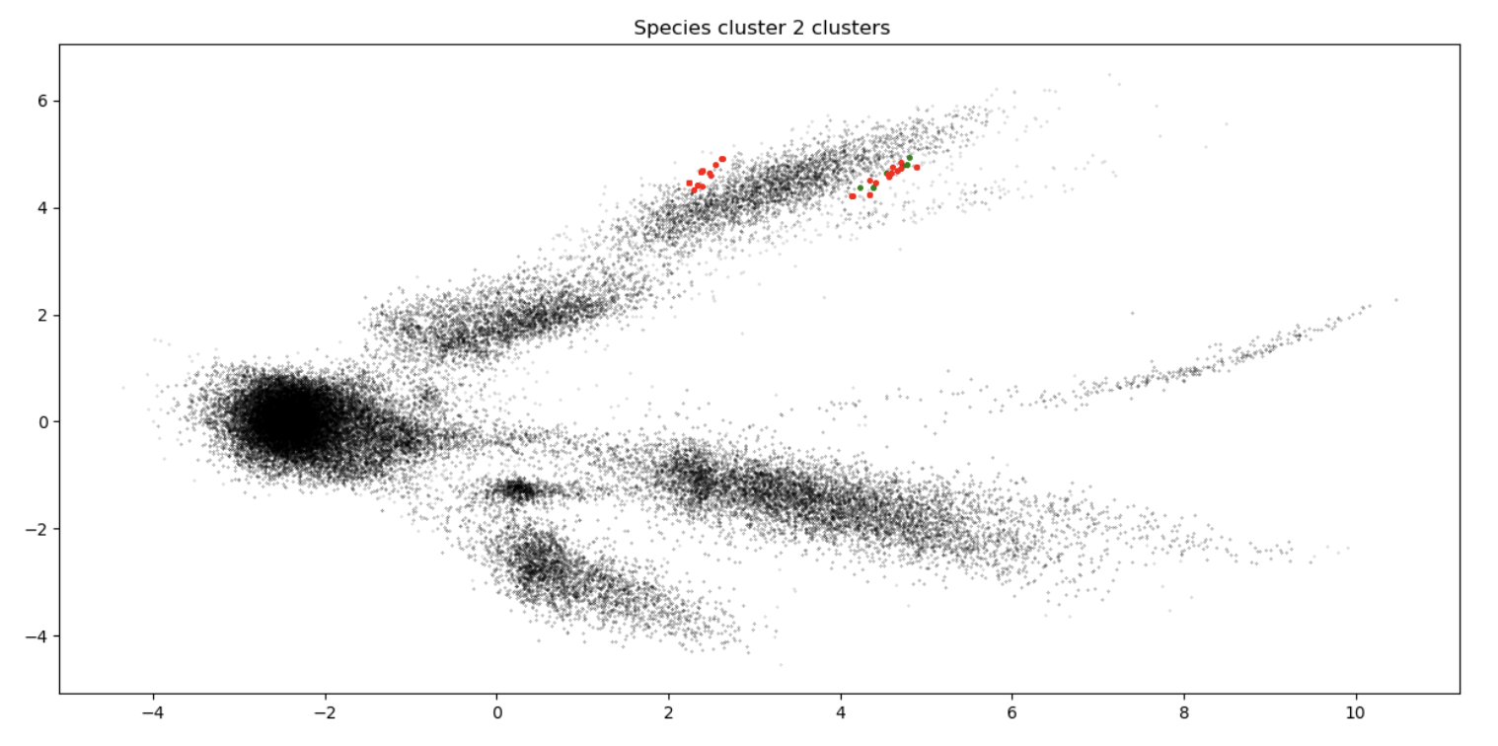
Hierarchical Clusters analysis

Slide 26
Interactive tools for different use cases
For global approach: Nested hierarchical clustering tool and comparing subclusters with their node graphs (top words /top hypernyms)
For local investigations: Selecting specific observation and find the nearest n numbers of closest observations.

Slide 27
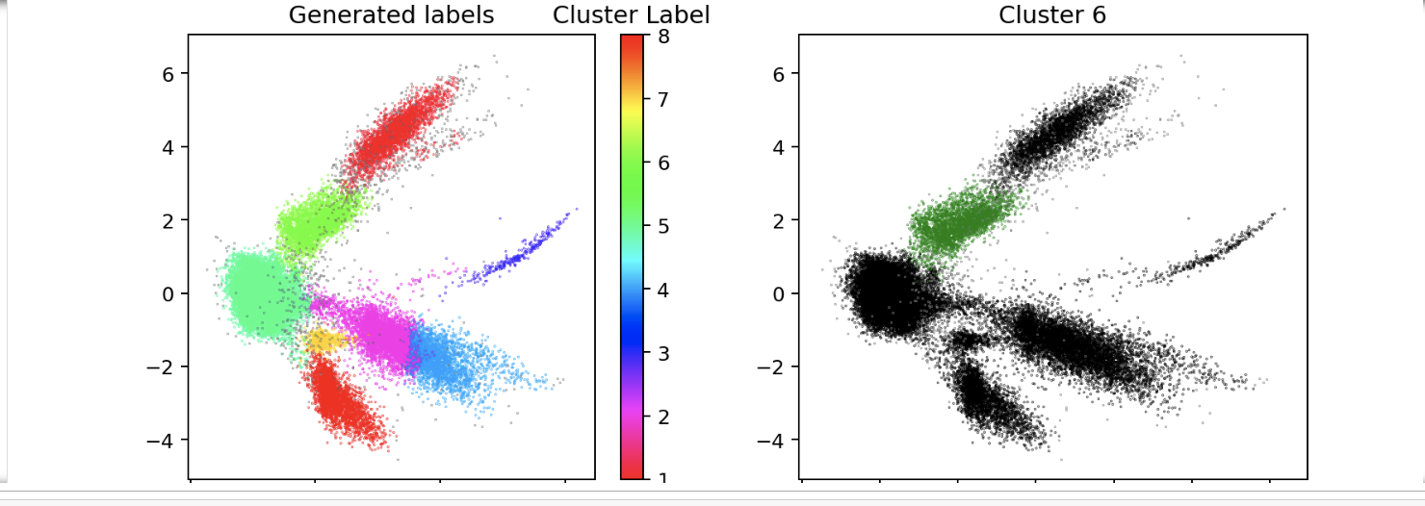
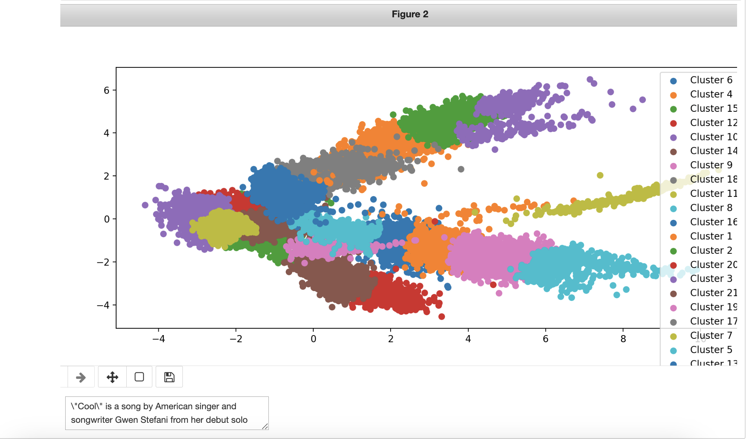
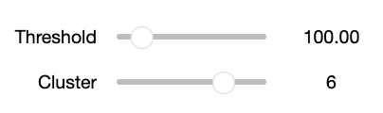
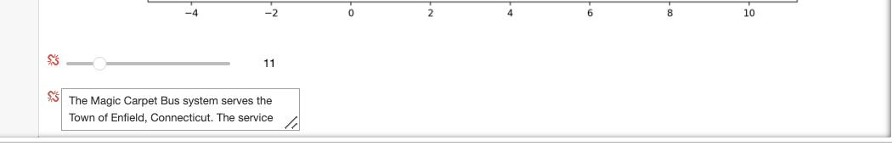
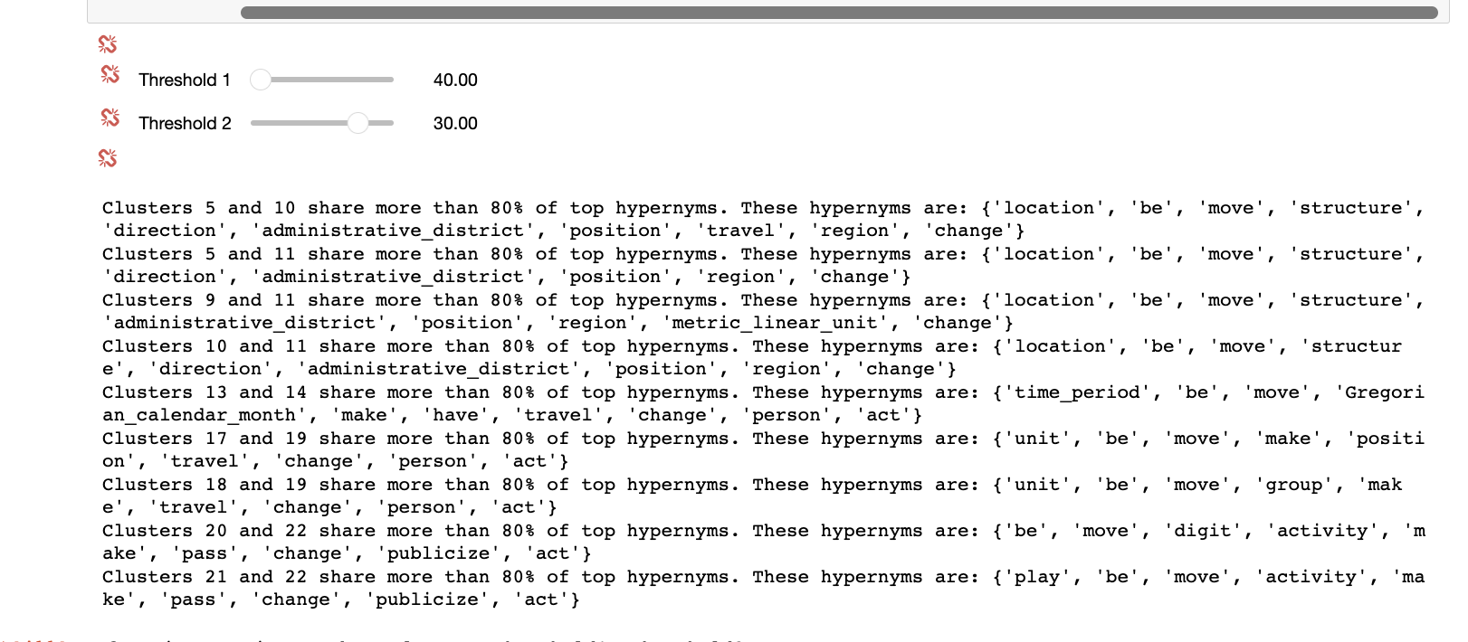
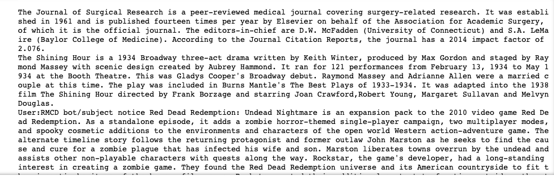
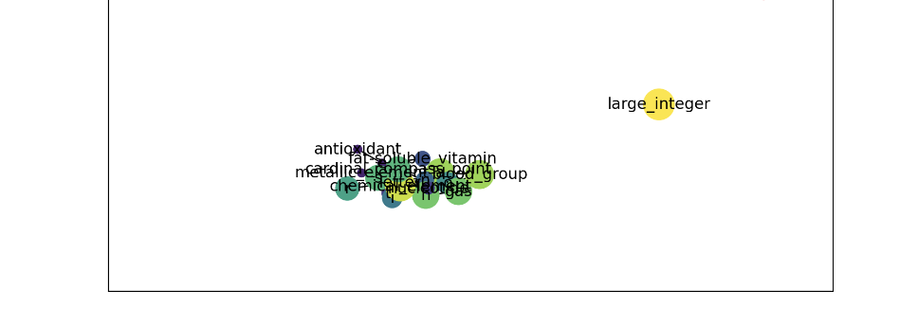
Interactive tools for different use cases

Slide 28
Thank you !

